Slide 1
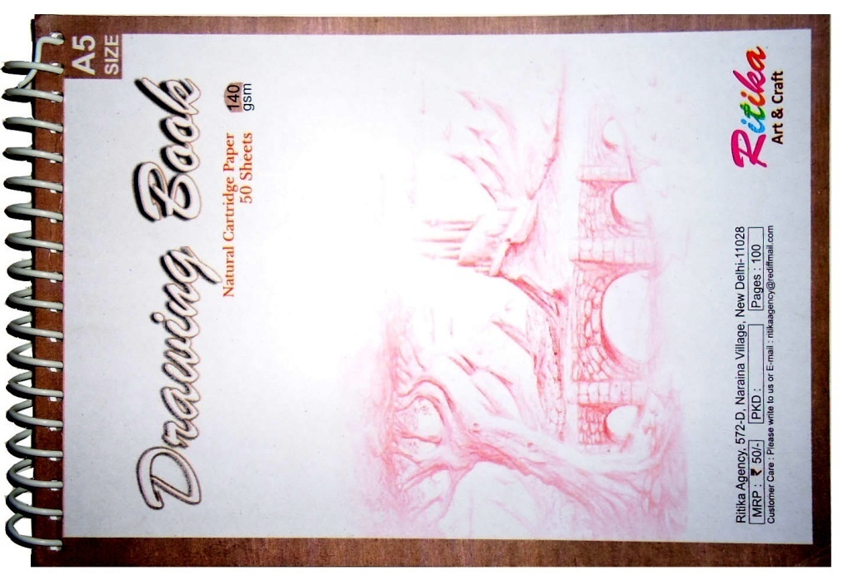
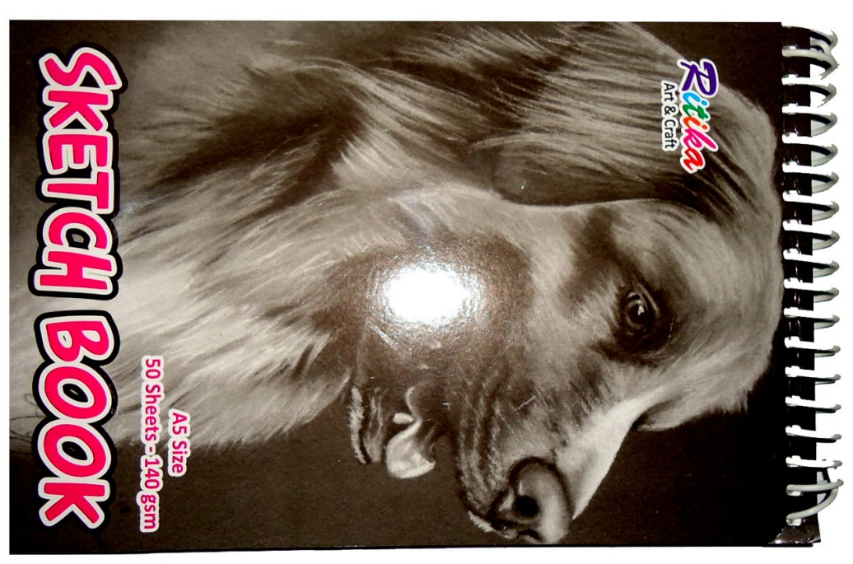
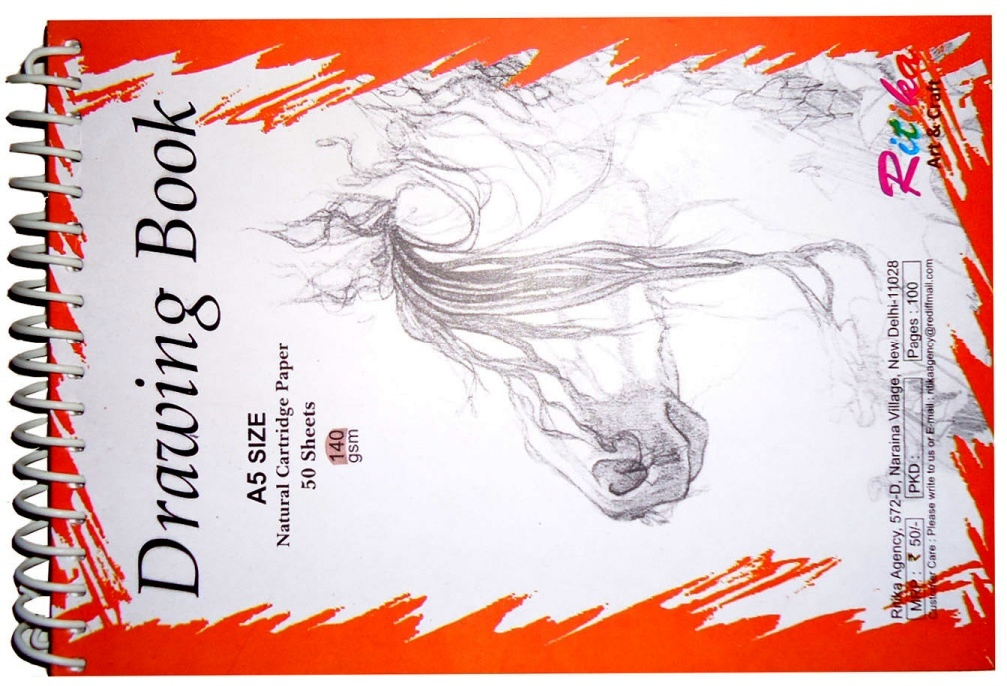
Drawing book size A5
50 sheets
M.r.p -55/-

Slide 2
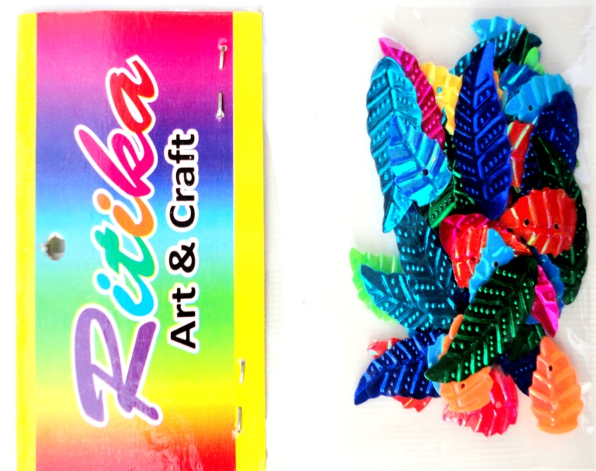
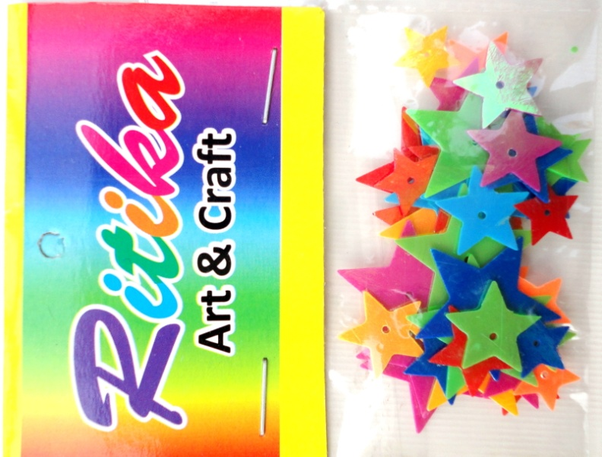
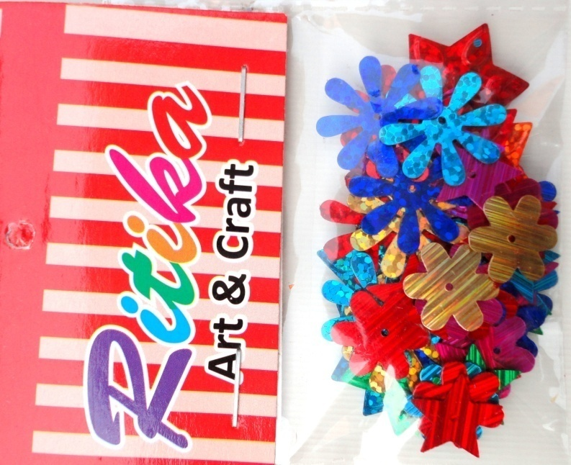
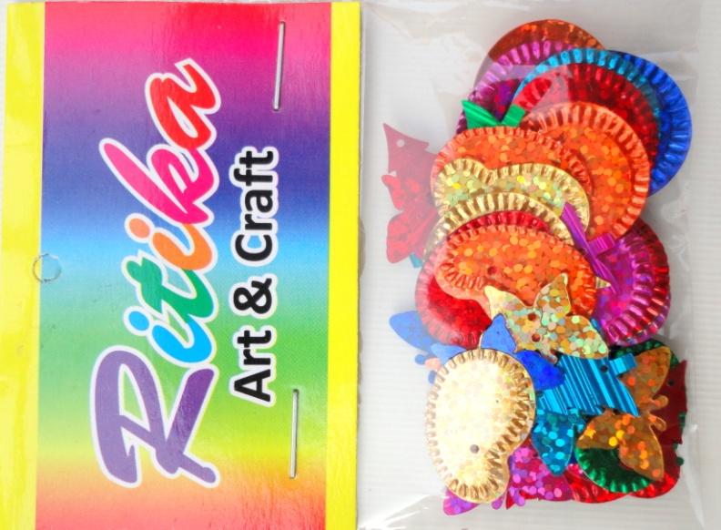
ART &CARFT 1
ART &CARFT 2
ART &CARFT 3
ART &CARFT 4

Slide 3

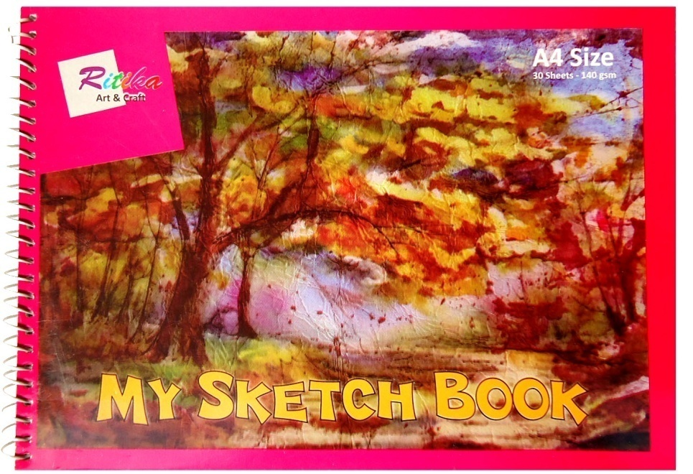
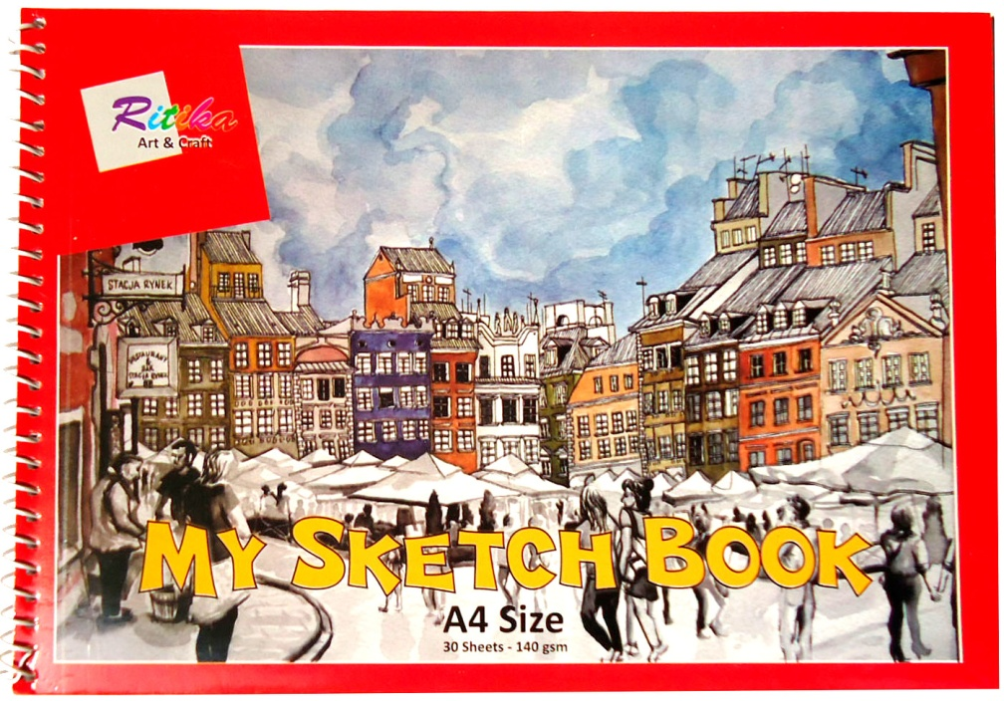
Sketch book size A4
Off white paper cartridge
30 sheets m.r.p-35/-

Slide 4
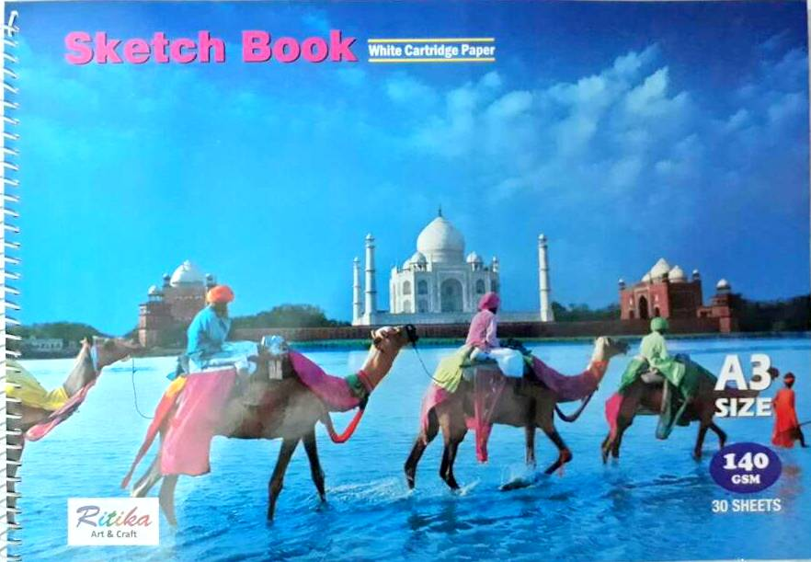
Sketch book size A3
Super white cartridge paper
30 sheets m.r.p-165/-

Slide 5

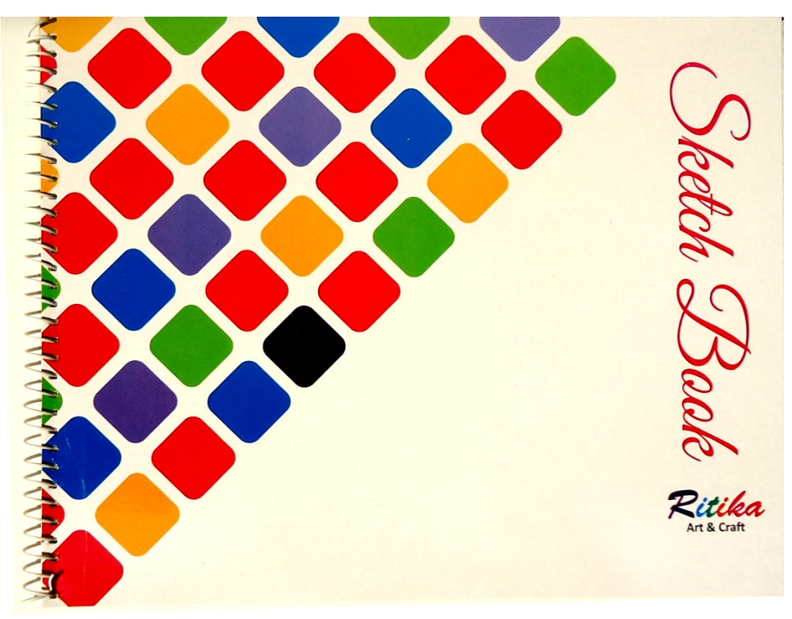
Big size SKETCH BOOK
OFF-WHITE (18 sheets)
m.r.p- 50 /-
Big size SKETCH BOOK
OFF-WHITE (36 sheets)
m.r.p - 90/-

Slide 6
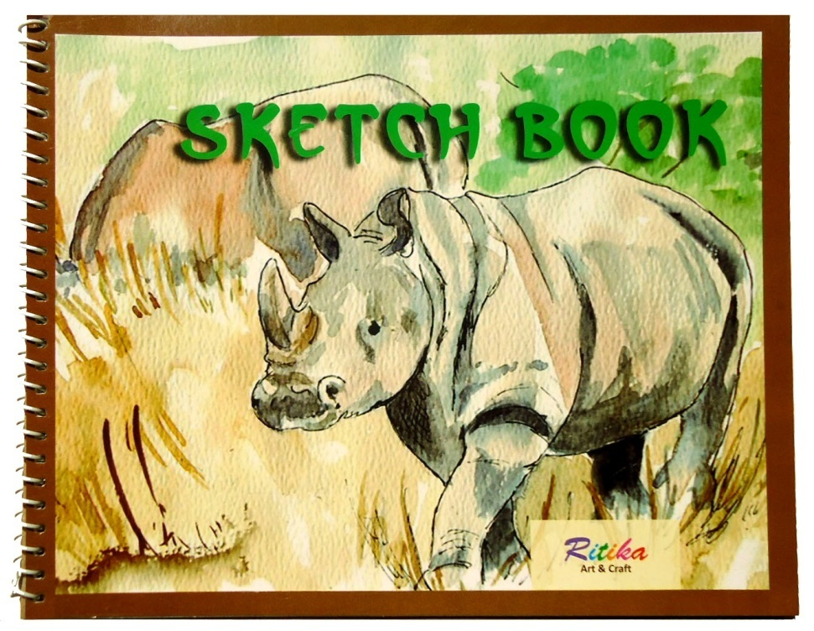

SKETCH BOOK SMALL
OFF-WHITE (18 PAGES )
M.R.P -15/-
SKETCH BOOK SMALL
OFF-WHITE (36 PAGES )
M.R.P -30/-

Slide 7
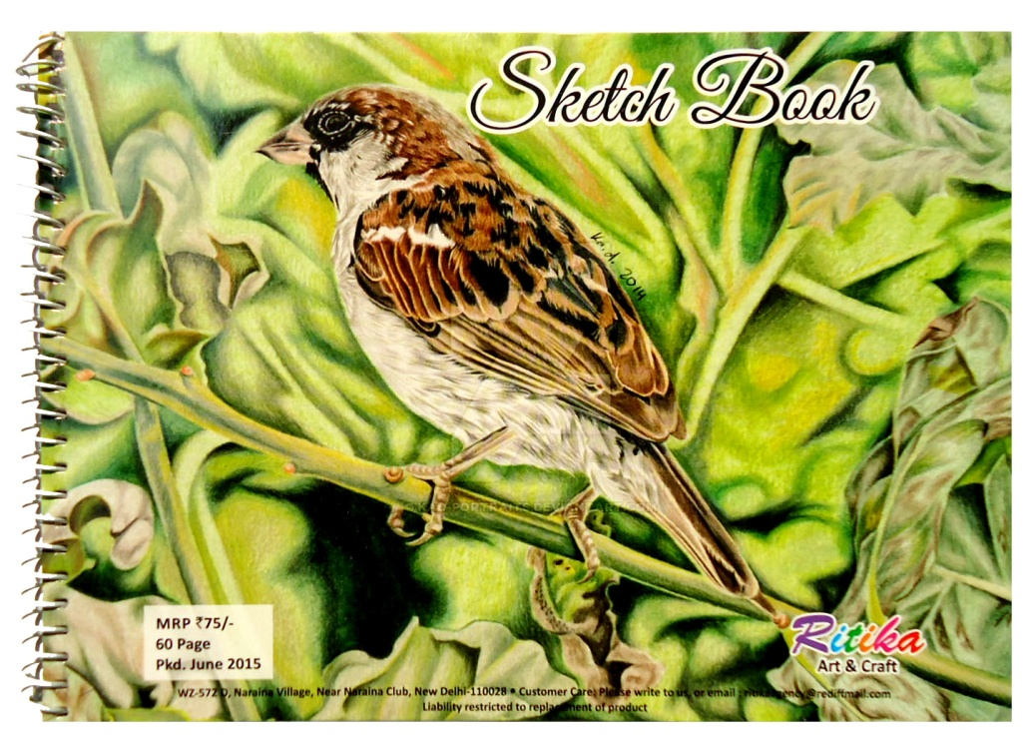

SKETCH BOOK a4 white cartridge
(30 sheets ) M.R.P -75/-
SKETCH BOOK a4 white cartridge
(50 sheets ) M.R.P -100/-

Slide 8
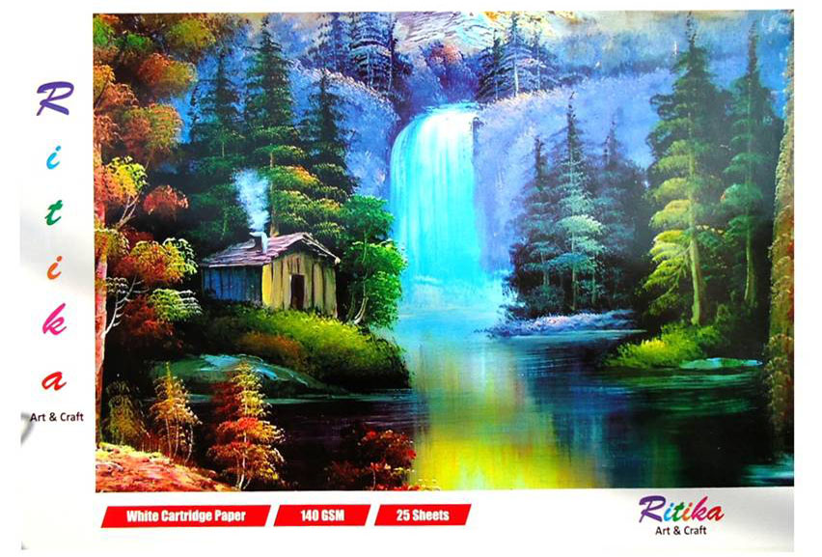
A2 pad WHITE CARTRIDGE PAGES
Sheets -25
M.R.P-140/-

Slide 9
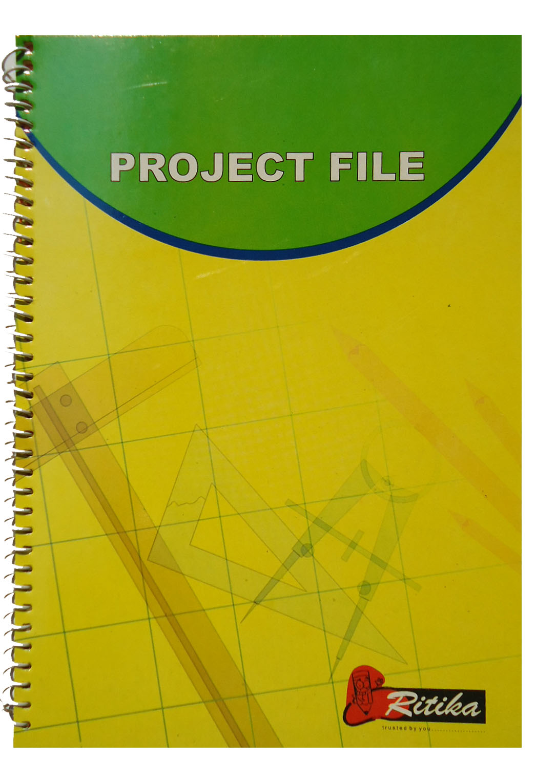

PROJECT FILE
(40 PAGES)
M.R.P -50
SCRAP BBOOK
(32 PAGES)
M.R.P -30

Slide 10
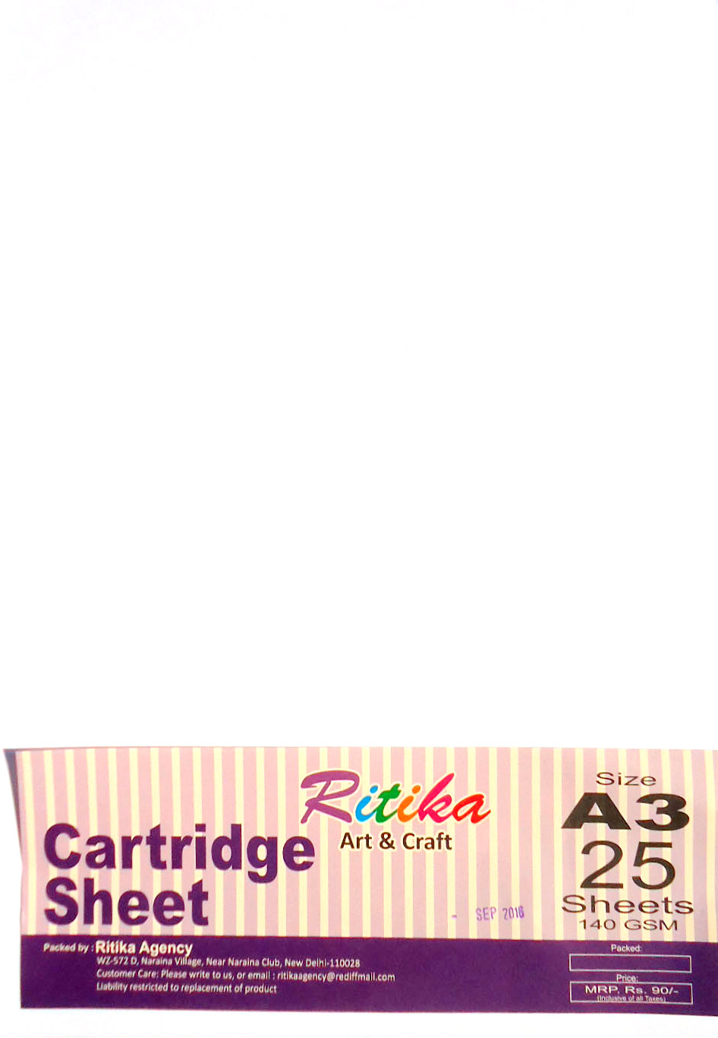
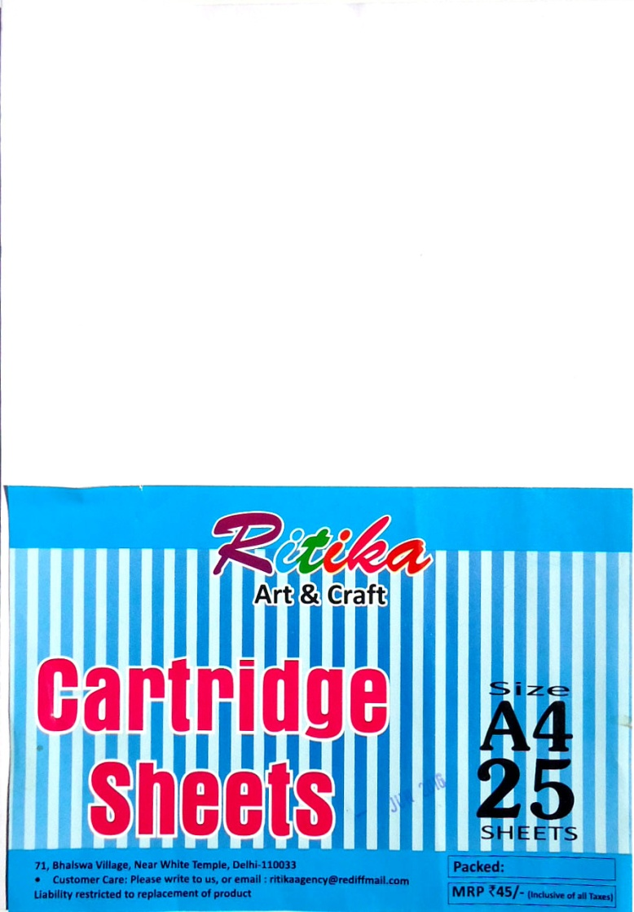
A-3 CARTRIDGE (25 SHEETS)
M.R.P- 100/-
A-4 CARTRIDGE (25 SHEETS)
M.R.P- 50/-

Slide 11
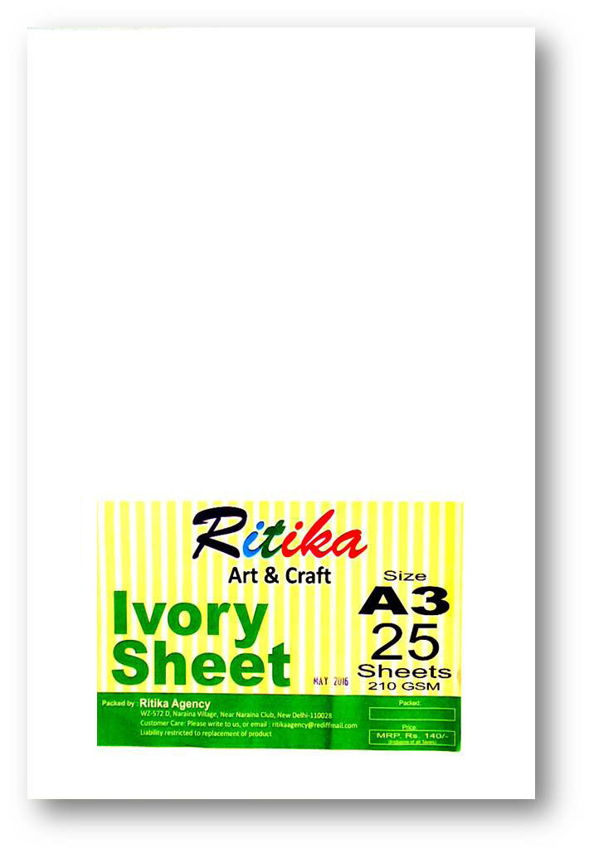
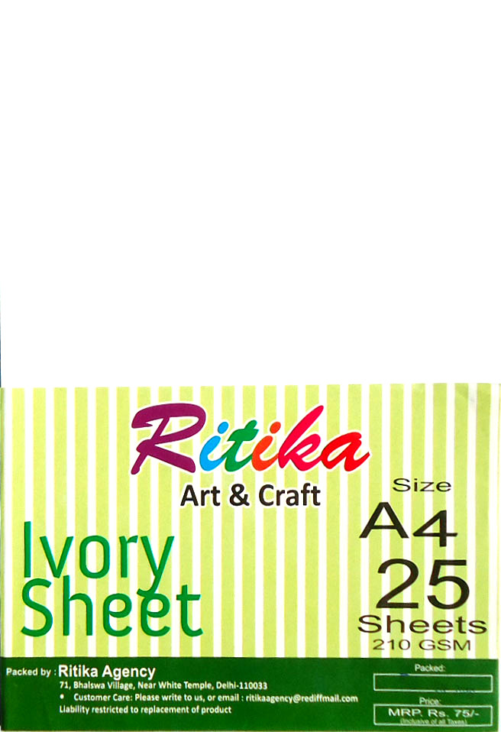
A-4 IVORY PAPER (25 SHEETS)
M.R.P- 75/-
A-3 IVORY PAPER (25 SHEETS)
M.R.P- 140/-

Slide 12
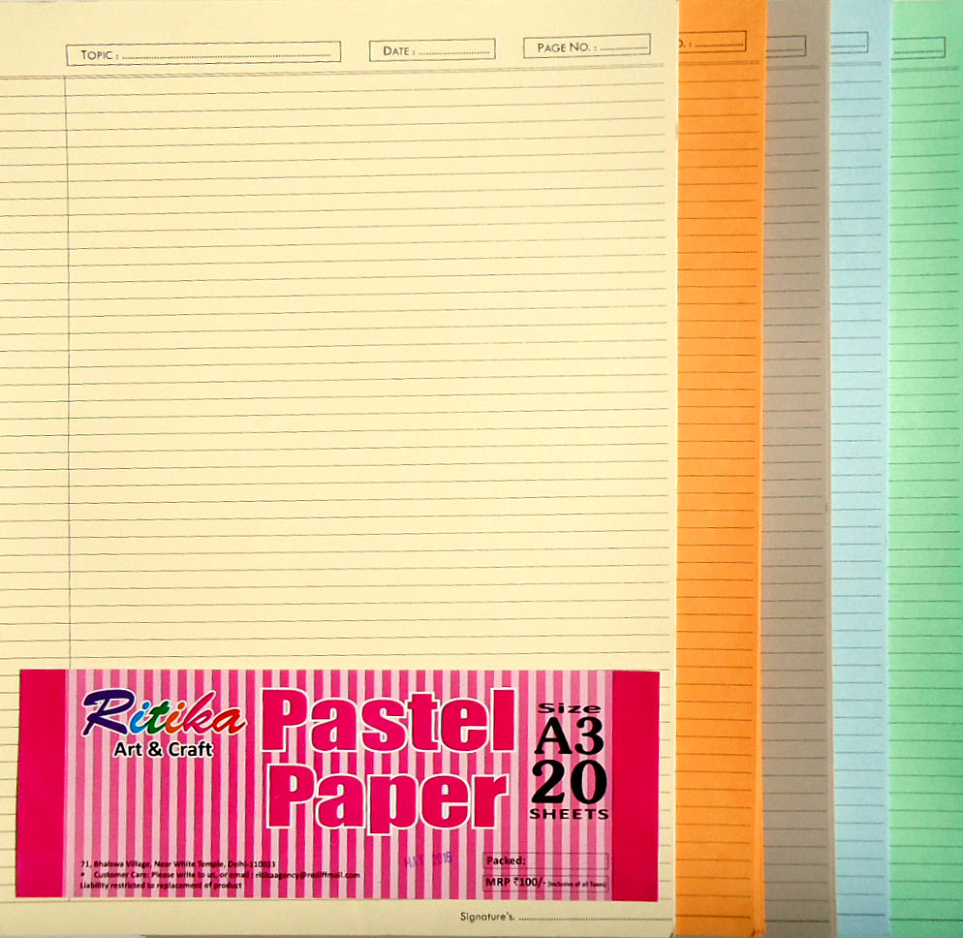
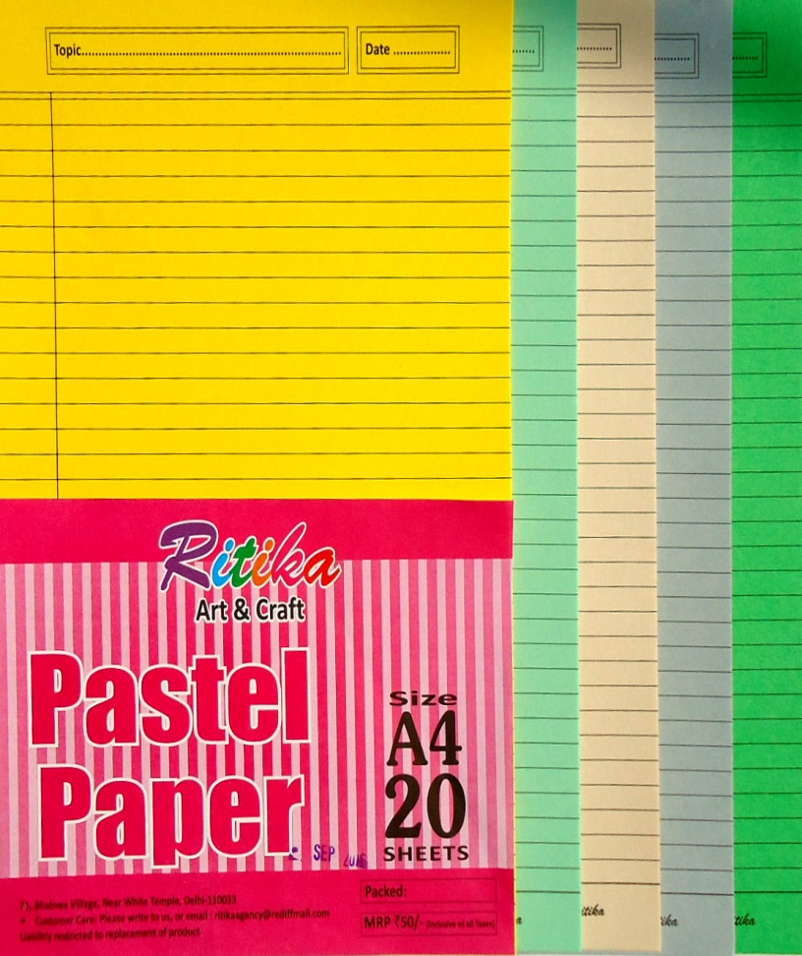
A4 one side ruled coloured
PASTEL PAPPER (20 SHEETS)
M.R.P -50/-
A3 one side ruled coloured
PASTEL PAPPER (20 SHEETS)
M.R.P -100/-

Slide 13
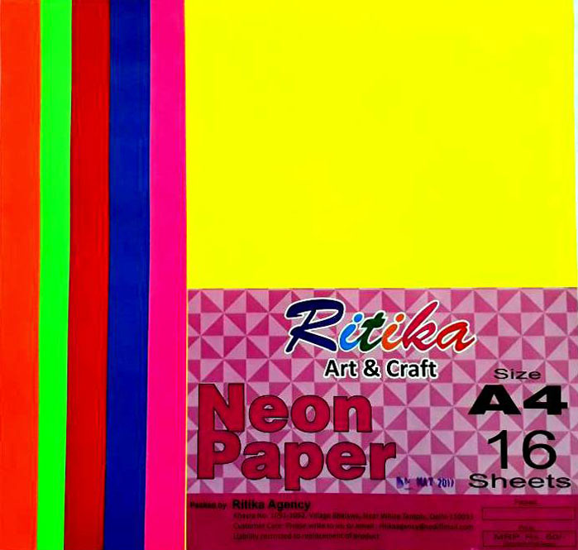
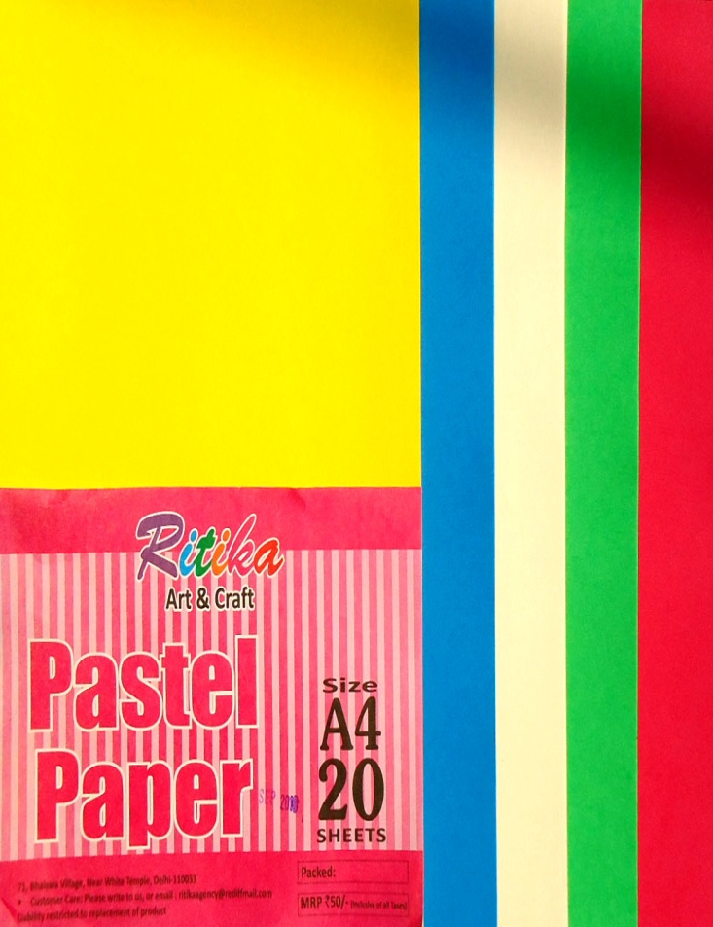
Neon paper assorted
A4 (16 SHEETS )
M.R.P -60/-
PASTEL PAPPER assorted
A4 (20 SHEETS )
M.R.P -50/-

Slide 14
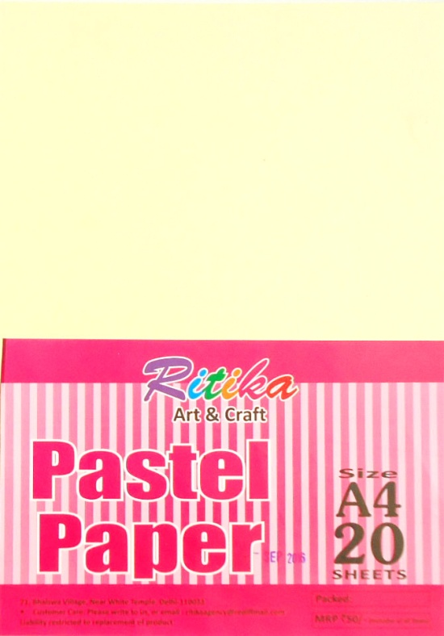
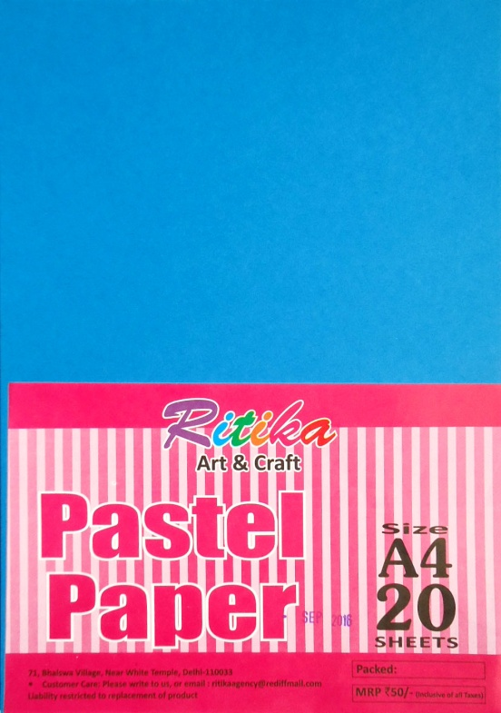
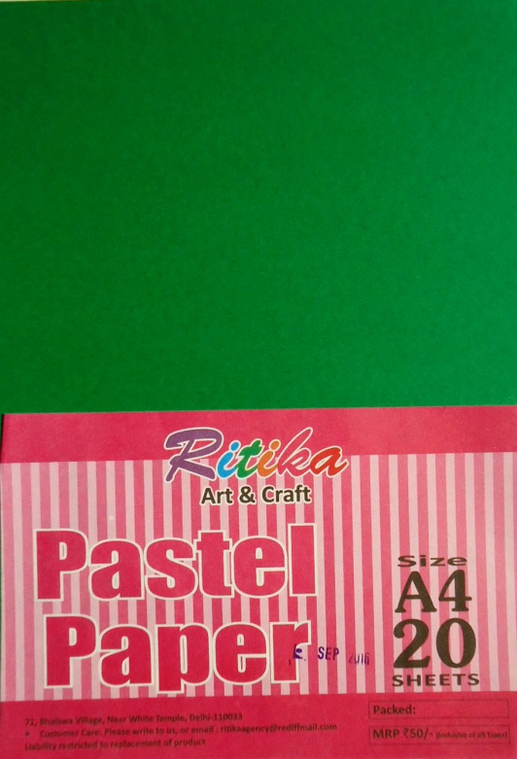
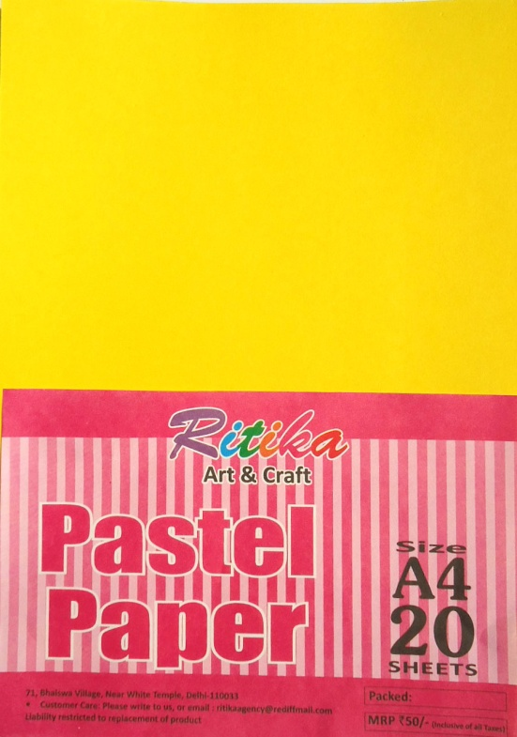
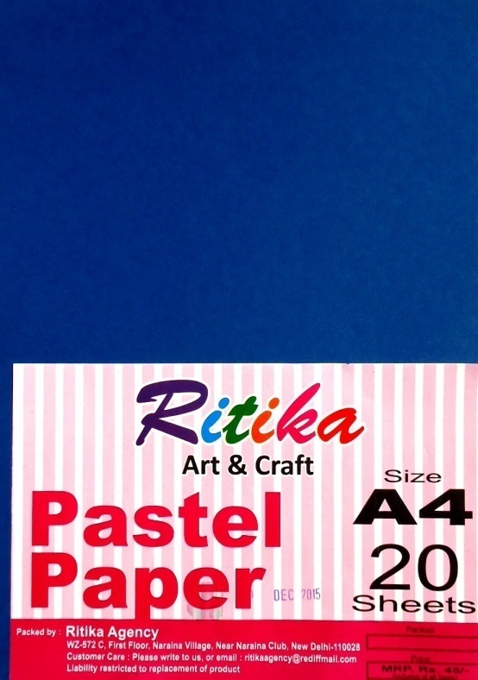
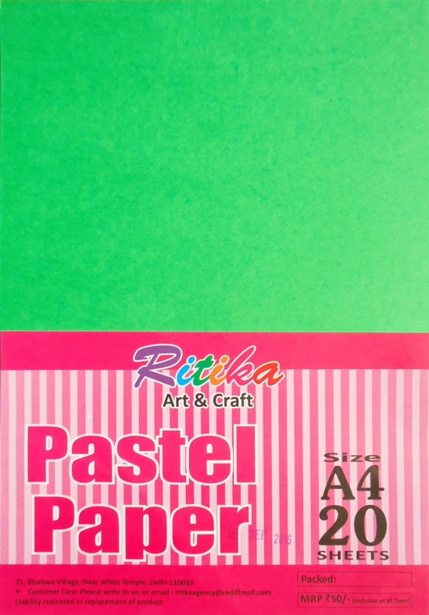

Slide 15
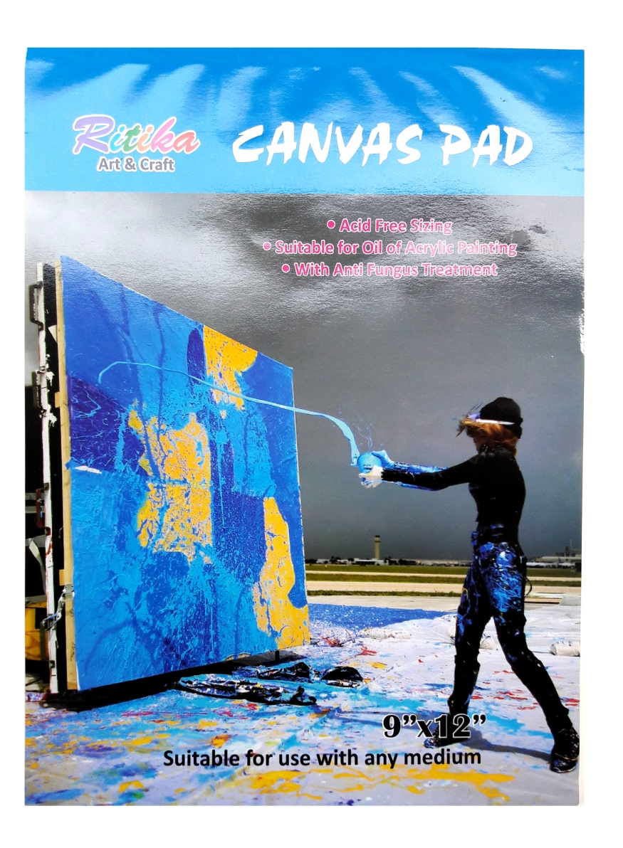
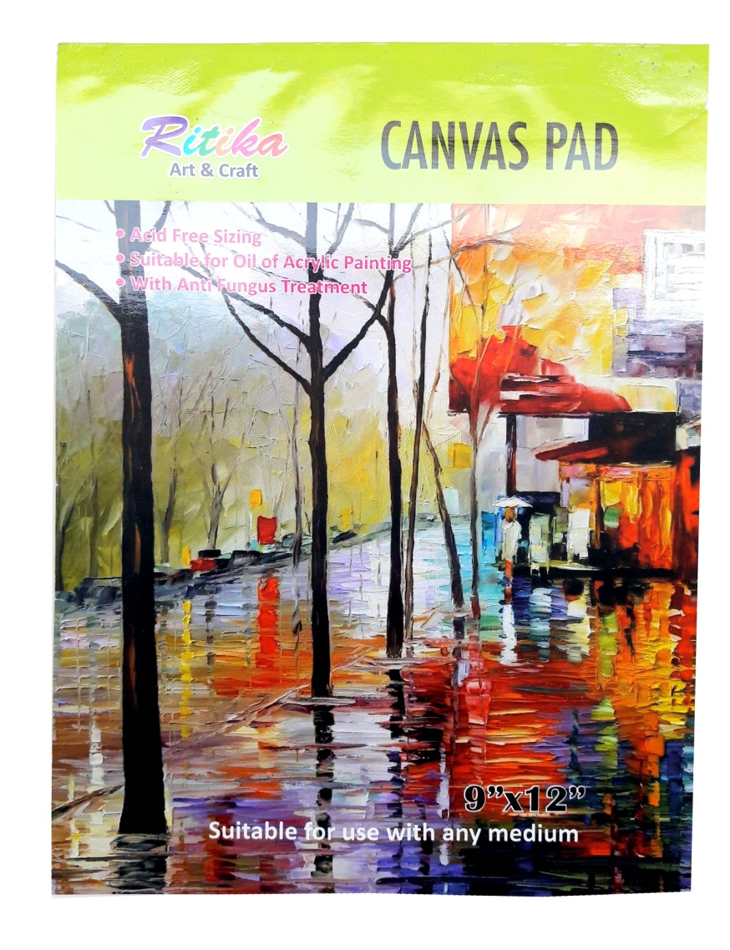
CANVAS PAD
Size-9x12
M.R.P-220
CANVAS PAD
Size-9x12
M.R.P-220

Slide 16

CANVAS BOARD 6X6 - 25
CANVAS BOARD 8X10 - 50
CANVAS BOARD 10X12 - 75
CANVAS BOARD 12X12 - 95
CANVAS BOARD 12X16 - 125
CANVAS BOARD 14X18 - 160
CANVAS BOARD 16X20 - 175
CANVAS BOARD 18X24 - 225
CANVAS BOARD

Slide 17
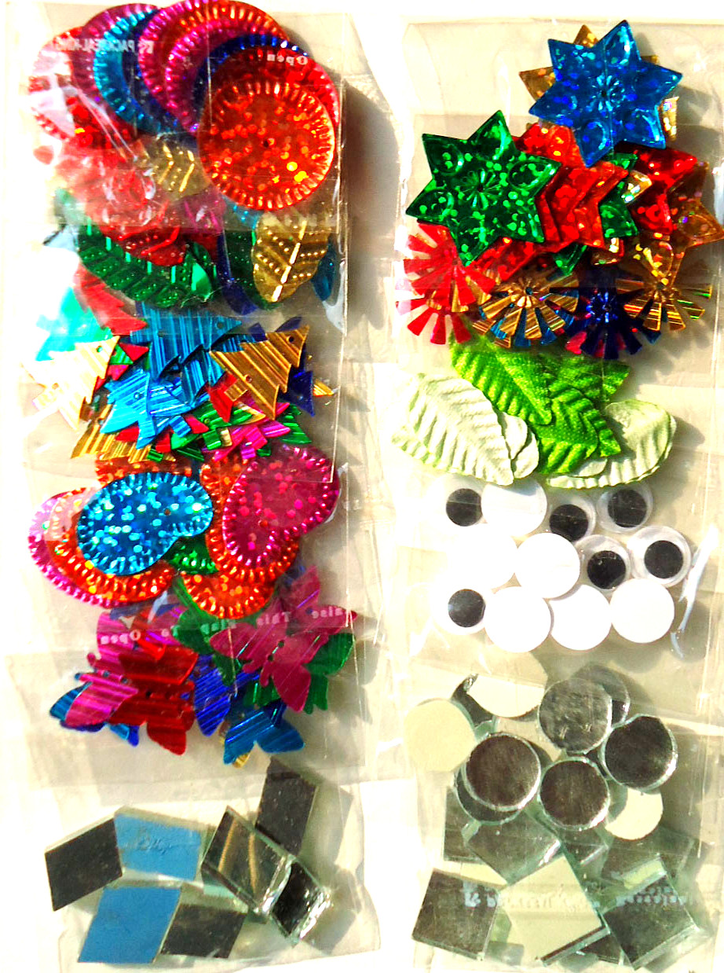
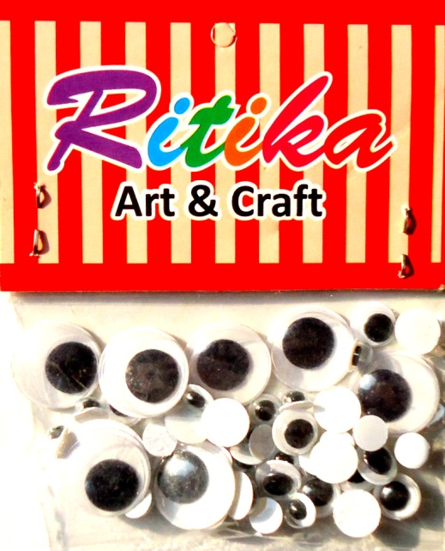
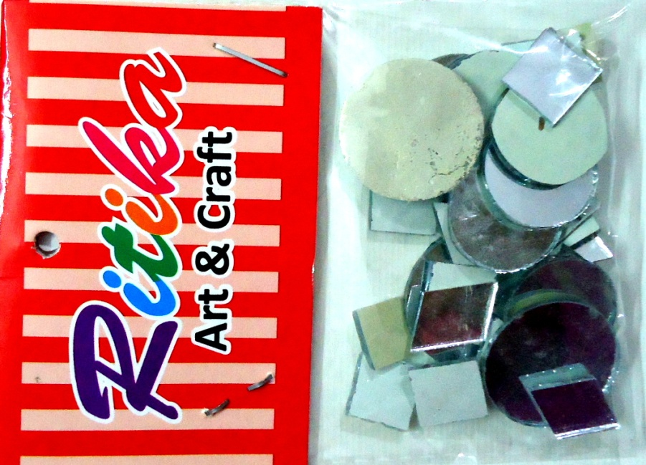
Art and craft set 12 different items
m.r.p 25/-

Slide 18

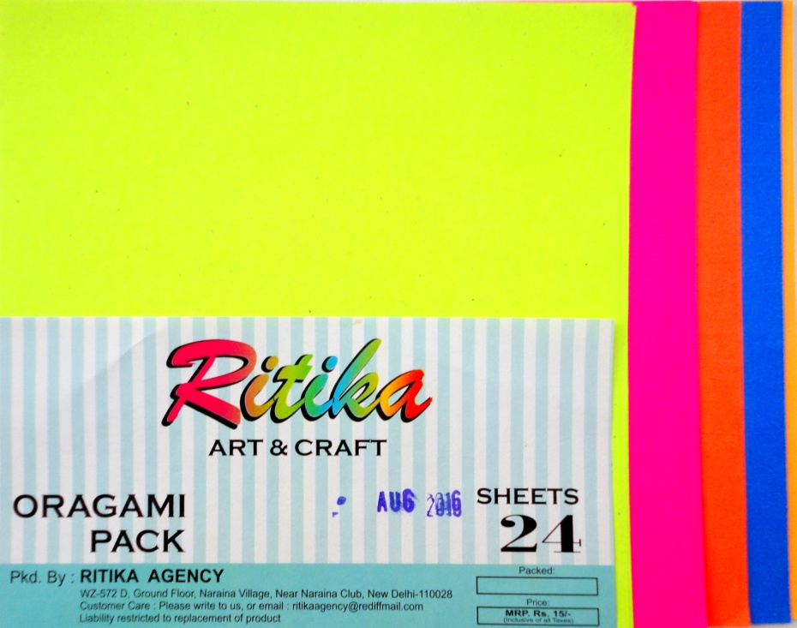
Oragami paper
Light weight
Sheets--24
Oragami paper
Heavy weight
Sheets--24

Slide 19
Art & craft set
Contains 12 different items used as decorative materials

Slide 20
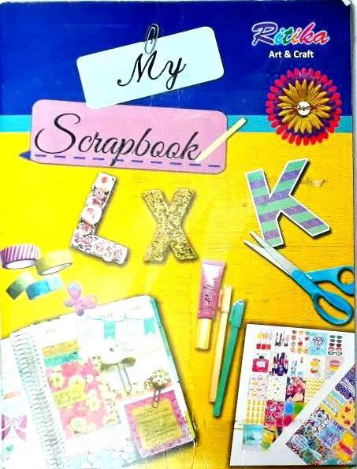
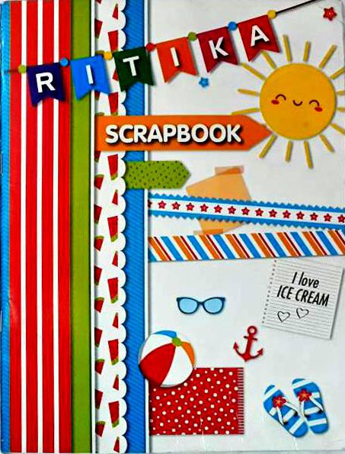
Scrap book ruled
32 pages
m.r.p 40/-
Scrap book plain
32 pages
m.r.p 40/-

Slide 21
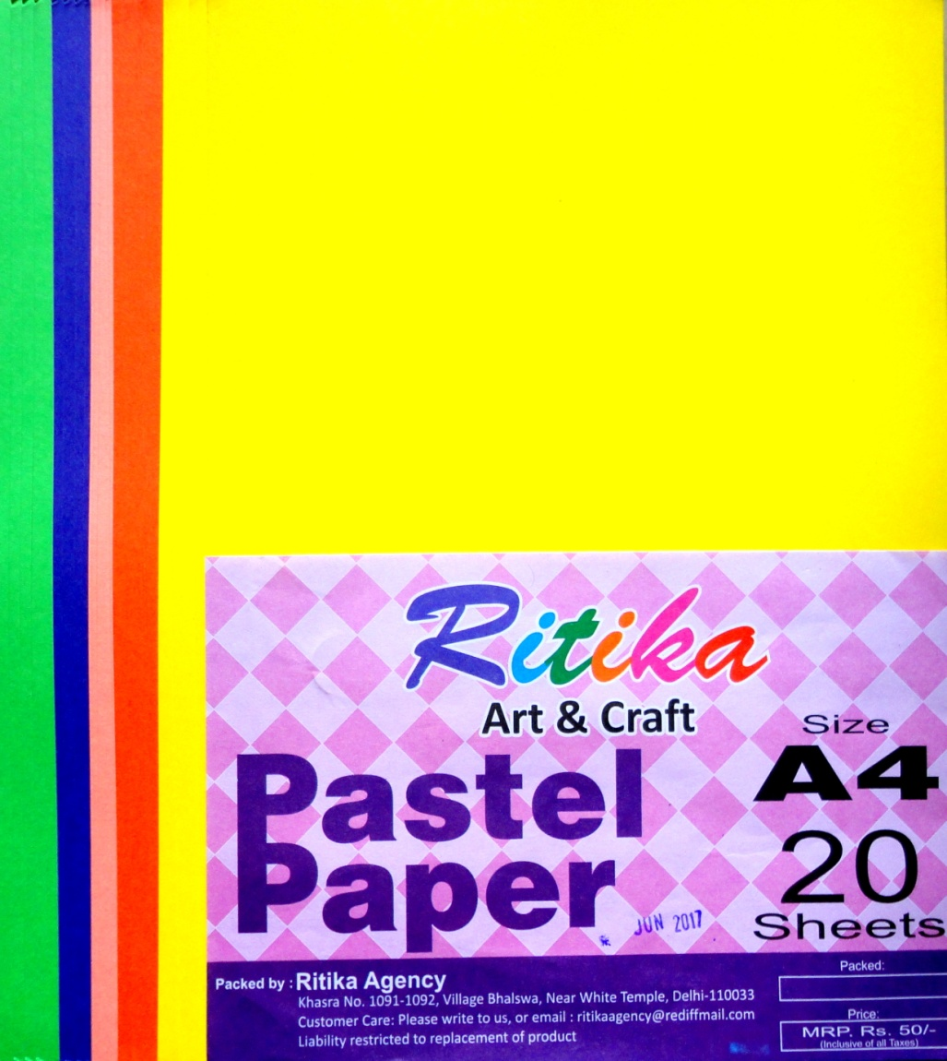
PASTEL PAPPER assorted
A4 (20 SHEETS )
M.R.P -50/-

Slide 22
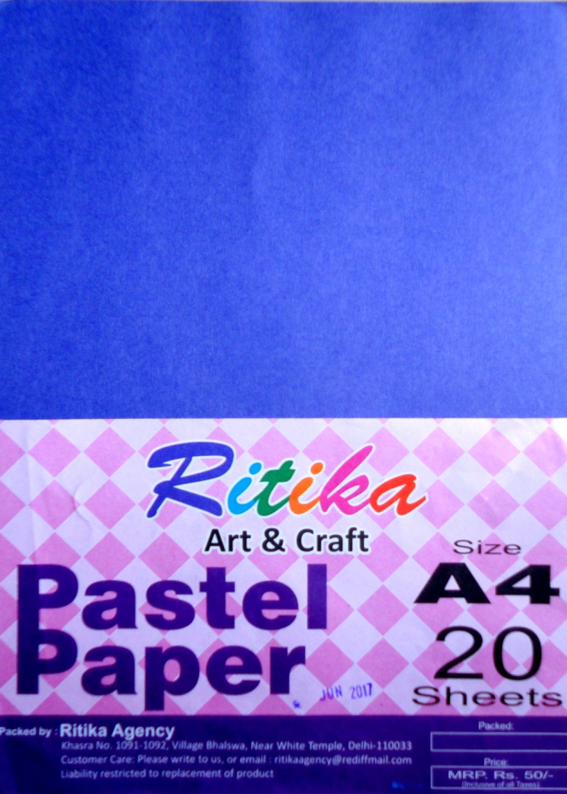
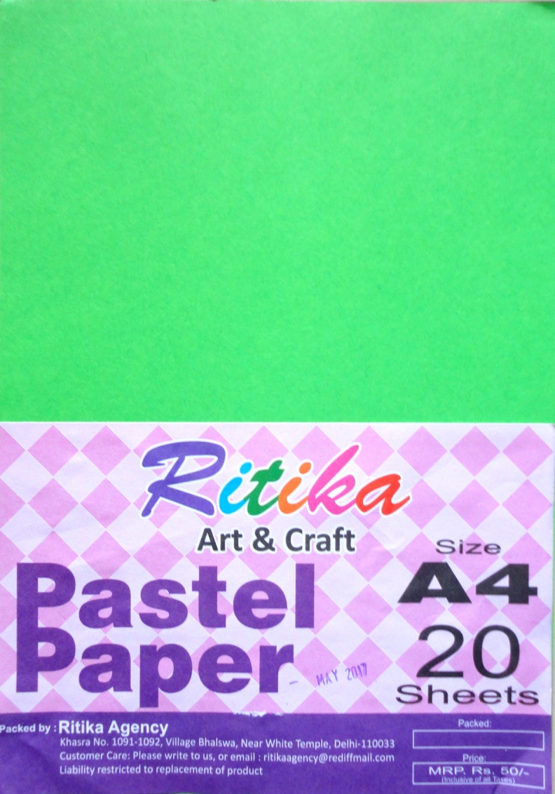
PASTEL PAPPER single (Blue)
A4 (20 SHEETS )
M.R.P -50/-
PASTEL PAPPER single (green)
A4 (20 SHEETS )
M.R.P -50/-

Slide 23
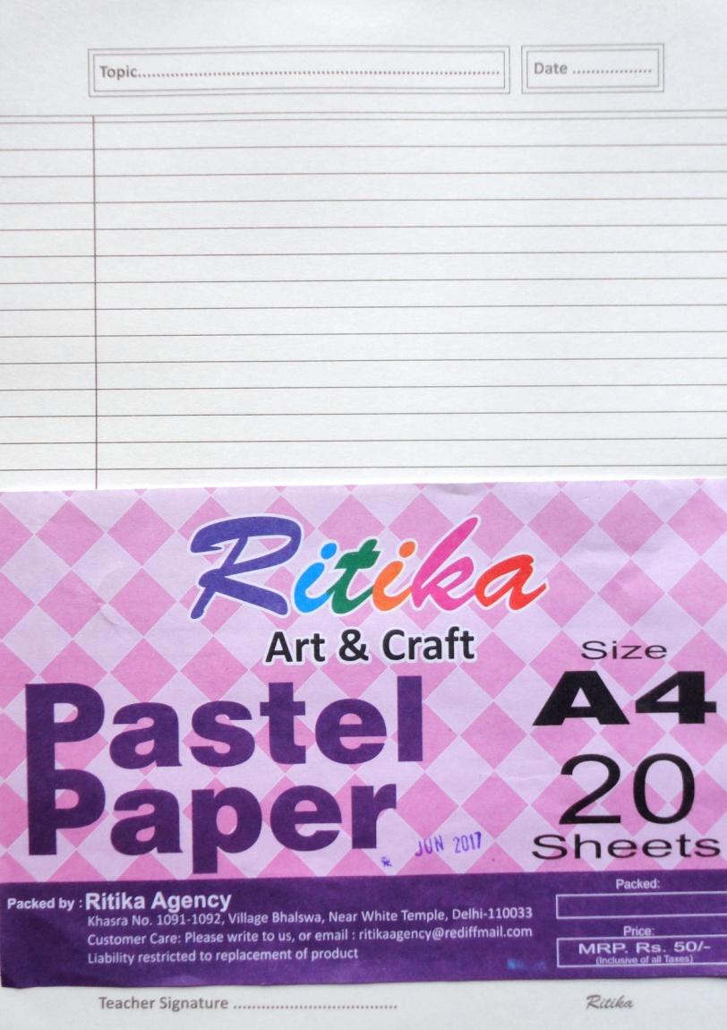
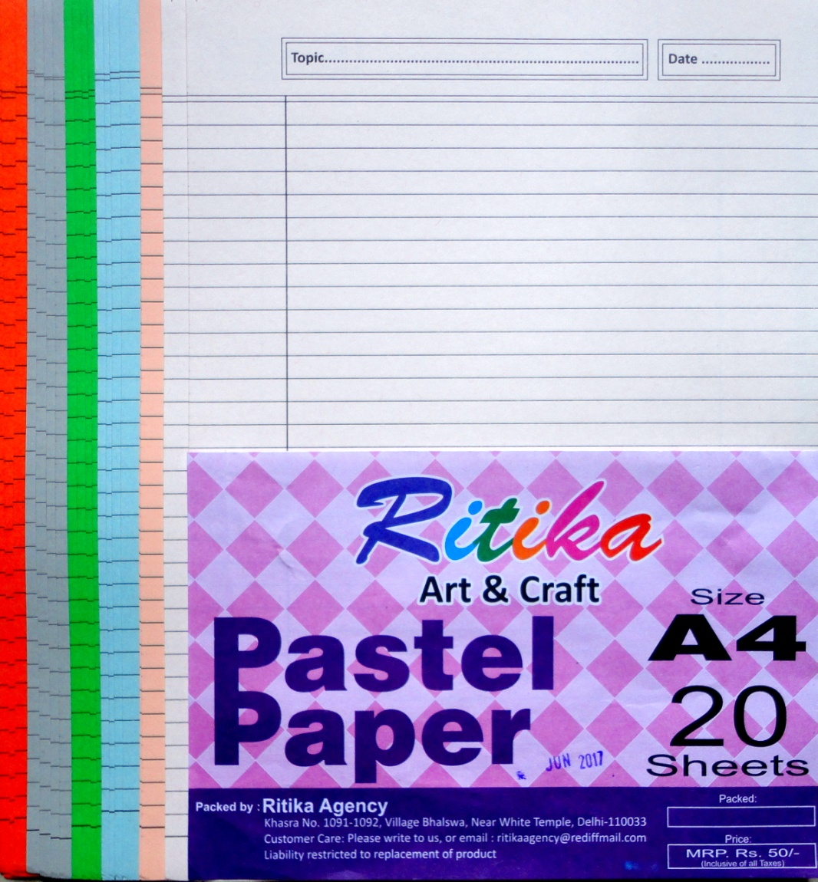

Slide 24
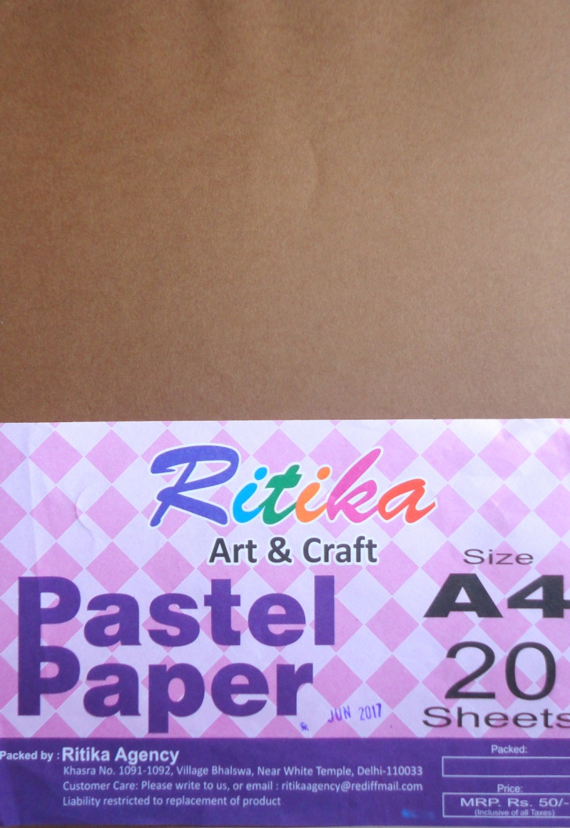
PASTEL PAPPER single (Brown)
A4 (20 SHEETS )
M.R.P -50/-

Slide 25
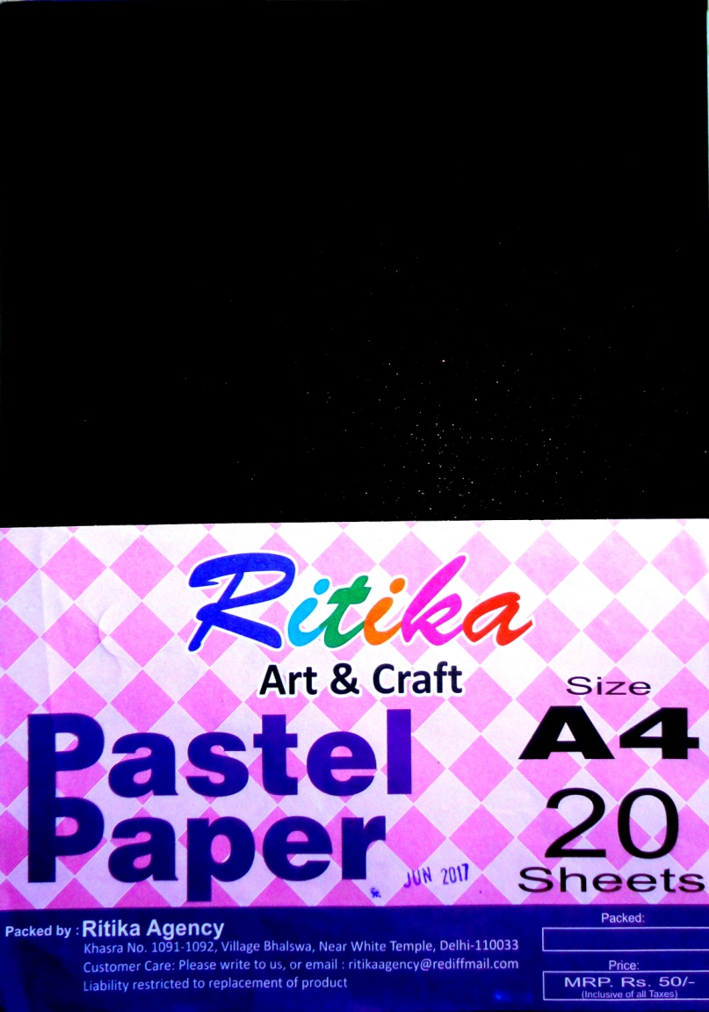
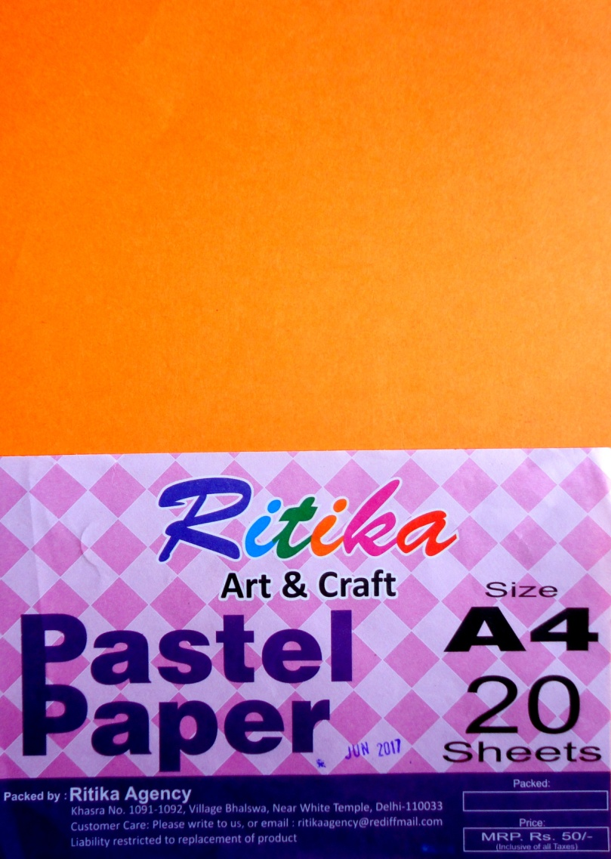
PASTEL PAPPER single (Black)
A4 (20 SHEETS )
M.R.P -50/-
PASTEL PAPPER single (orange)
A4 (20 SHEETS )
M.R.P -50/-
PASTEL PAPPER (Yellow)
A4 (20 SHEETS )
M.R.P -50/-

